Slide 1

SE577:Software Architecture
Week 1: Course Overview
Dr. Brian Mitchell
Spring 2022
Drexel University

Slide 2
About the Instructor
Dr. Brian Mitchell
Professor in Computer Science
Background
B.S., M.S., and Ph.D. in Computer Science
M.E. in Computer and Telecommunication Engineering
Involved with CS Department Teaching, Research and Industry collaboration since 1997
Ph.D. work in Software Architecture Recovery
Contact Information
Email: bmitchell@Drexel.edu
Office Hours: by appointment
Webpage: https://www.cs.drexel.edu/~bmitchell/
Course Slack Workspace: https://drexel-se577-2022.slack.com/

Slide 3
Teaching Assistant Information
Mr. Sean Grimes (spg63@drexel.edu)
Office Hours: TBD

Slide 4
About this course
Objectives
Teach students about the knowledge, duty, and skills needed by software architects
Teach students the essential skills of software architecture modeling and analysis
Teach students architecture patterns and styles
Teach students how to specify and analyze quality attributes
Teach students how to analyze architecture embodied in open source projects.
Teach students advanced topics in architectural design.

Slide 5
About this course
Learning outcomes: students completing this course should be able to:
Apply architectural principles and skills to create software systems
Model software architecture and analyze various trade-offs.
Apply architectural patterns to solve real problems
Identify architectural styles in open source projects
Analyze software requirements and choose proper architecture styles.
Reason about architecture quality attributes.

Slide 6
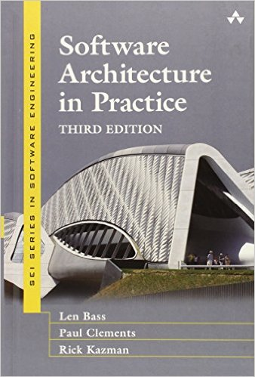
Learning Material
Reference Book 1:
“Software Architecture in Practice”
4th Edition, by Len Bass, Paul Clements, Rick Kazman

Slide 7
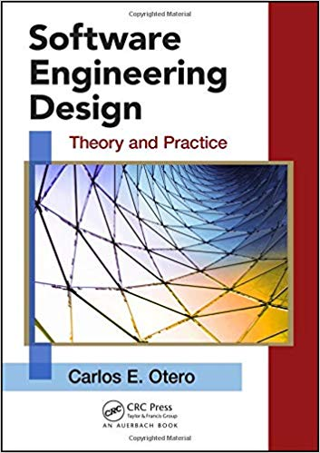
Learning Material
Reference Book 2:
“Software Engineering Design: Theory and Practice”
First Edition, by Carlos Otero

Slide 8
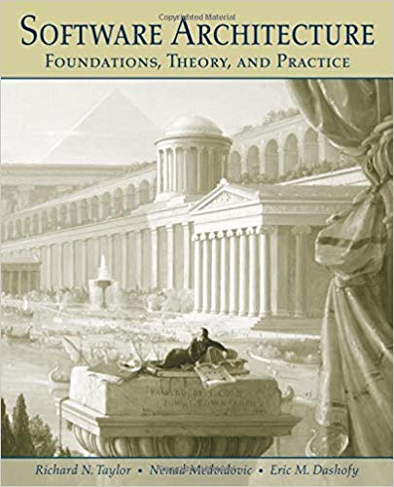
Learning Material
Reference Book 3:
“Software Architecture: Foundations, Theory, and Practice”
First Edition, by R. N. Taylor, N. Medvidovic, E. M. Dashofy

Slide 9
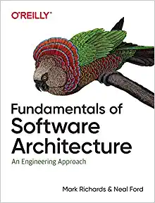
Learning Material
Reference Book 4:
“Fundamentals of Software Architecture”
by Mark Richards, Neil Ford

Slide 10
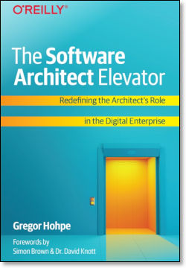
Learning Material
Reference Book 5:
“The Software Architect Elevator”
by Gregor Hohpe

Slide 11
Assignments, Assessments, and Evaluations
Individual assignment with multiple deliverables:
Design, analyze, and implement software architecture
Apply architecture patterns to achieve extensibility
Reason about various architecture quality attributes
Reading assignments, 2 foundational and 2 modern software architecture papers

Slide 12
Assignments, Assessments, and Evaluations
Grading Component:
Course Reading summaries and other assignments 40%
Course Project 50%
Participation: 10%

Slide 13
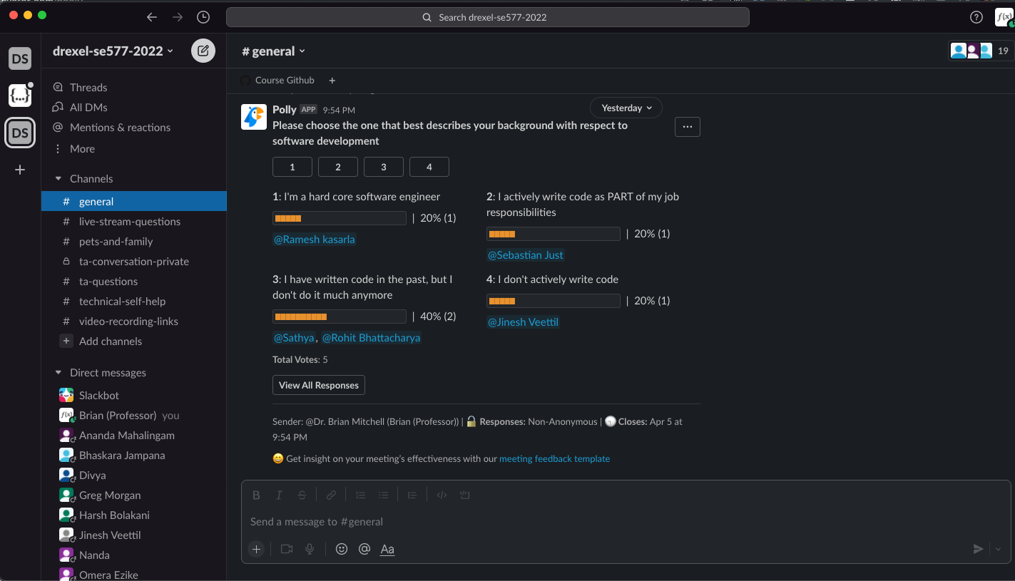
Slack will be our PRIMARY mode of communication
https://drexel-se577-2022.slack.com

Slide 14
A word about the technologies we will be using
We will be using modern technologies to demonstrate modern software architecture toolchains and implementation patterns
I will allow students to program in Java, but I will not be using Java in this class
My views about why its time to move away from Java for modern software engineering

